Slide 1

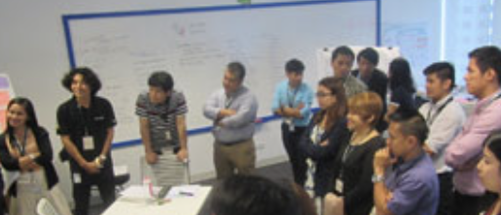
Make normal font, remove button treatment
Make links same gray as the rest, but upon upon make Chili Red (#C23B22).
Overlay on photo: Subtle black/charcoal gradient at 30–40% opacity behind text only, so it stays readable.
Text: Charcoal (#333333)
Button background: Chili Red: #C23B22
Text: #FAFAF5
Our Services #FAFAF5
Text : #333333
Color block: #DAD8D3

Slide 2

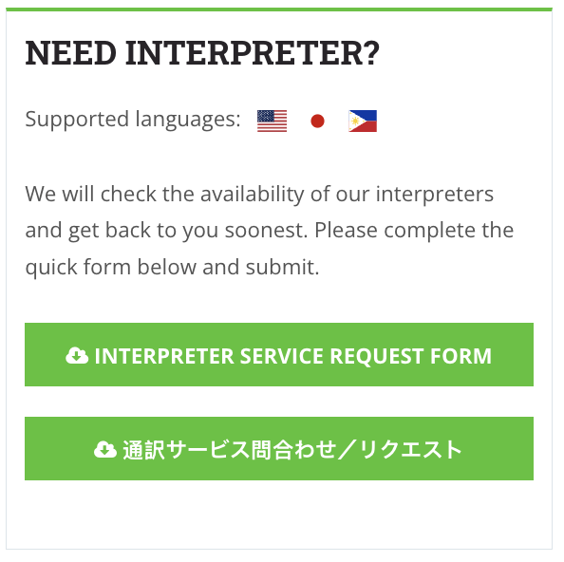
Change to
Make Deep Olive Green: #3E5E3A
Text : #FAFAF5
Color block: #7A8E72
Links in-line with text block:
Default state: Charcoal (#333333), bold (font-weight: 600 or 700).
Hover state: Chili Red (#C23B22), underline appears on hover.
Visited: Keep Charcoal (#333333) bold (don’t go purple/blue).
Active/Focus: Chili Red (#C23B22), underline stays (to meet accessibility).

Slide 3

🌶️ Color Scheme
🌶️ Font Scheme
Primary: Deep Olive Green: #3E5E3A
→ brand anchor (headers, buttons, nav bar).
Background: Warm Gray : #F2F2F0
→ softer than white, use as backdrop.
Accent CTA: Chili Red: #C23B22
→ hover links, icons, micro-accents (not body text).
Body Text: Charcoal: #333333
→ body text, professional and legible.
Hover Highlight: Sage Green: #7A8E72
→ button hover, subtle highlights.
Divider Stone Gray: #DAD8D3
→ section breaks, subtle contrasts.
Ivory (text on dark background): #FAFAF5
→ text or icons against green blocks.
Luxe Accent: Gold: #c9a552
→ Use VERY sparingly (maybe one section max).
Works well for a “Why Choose Us” or Awards/Partners section.
Heading: Open Sans Bold
Body Text: Open Sans
Quotes: Open Sans Italic

Slide 4
🔑 Button Hierarchy
1. Primary CTA (Chili Red #C23B22)
Reserve ONLY for business-critical conversions:
“Get Started”
“Book a Consultation”
“Contact Us”
Ideally one per screen/section (never two red buttons fighting each other).
2. Secondary Actions (Olive Green #3E5E3A)
Use for supporting actions that matter but aren’t the main goal.
“Learn More”
“View Services”
“Read Case Study”
These keep the user engaged without diluting CTA urgency.
3. Tertiary / Utility (Text links or Outline buttons)
For navigation-type actions or things that aren’t “decisions.”
“Back to Top”
“Download PDF”
“View All Articles”
Use muted gray borders or simple underlined text, not filled buttons.
📊 Ratio Rule of Thumb
1 Red CTA per viewable screen
(hero, mid-page, footer).
2–3 Secondary buttons per section
styled green or outlined.
Unlimited tertiary actions as text links.

Slide 5
/* ================================
SPICEWORX STYLE SHEET
================================ */
/* --- Fonts --- */
body {
font-family: 'Open Sans', sans-serif;
font-size: 16px;
line-height: 1.6;
color: #333333; /* Charcoal text */
background-color: #F2F2F0; /* Warm Gray backdrop */
}
/* --- Headings --- */
h1, h2, h3, h4, h5, h6 {
font-family: 'Open Sans', sans-serif;
font-weight: 700; /* Bold */
color: #333333; /* Charcoal */
margin: 1.2em 0 0.5em;
}
/* --- Paragraphs / Body --- */
p {
font-family: 'Open Sans', sans-serif;
font-weight: 400;
color: #333333;
margin: 0 0 1em;
}
/* --- Quotes --- */
blockquote {
font-family: 'Open Sans', sans-serif;
font-style: italic;
color: #333333;
border-left: 4px solid #E0E0DC; /* Divider Gray */
padding-left: 1em;
margin: 1.5em 0;
}
/* --- Links --- */
a {
font-weight: 600; /* Bold */
color: #333333; /* Charcoal by default */
text-decoration: none;
transition: color 0.3s ease, text-decoration 0.3s ease;
}
a:hover,
a:focus {
color: #C23B22; /* Chili Red */
text-decoration: underline;
}
a:visited {
color: #333333; /* Keep consistent, no purple/blue */
}
/* --- Buttons --- */
/* CTA Button (ONE per page) */
.btn-cta {
display: inline-block;
background-color: #C23B22; /* Chili Red */
color: #FAFAF5; /* Ivory text */
font-weight: 600;
padding: 0.75em 1.5em;
border: none;
border-radius: 6px;
text-transform: uppercase;
letter-spacing: 0.5px;
cursor: pointer;
transition: background-color 0.3s ease;
}
.btn-cta:hover {
background-color: #A12F1C; /* Darker Chili on hover */
}
/* Secondary Buttons (all others) */
.btn-secondary {
display: inline-block;
background-color: #5A8E49; /* Muted Green */
color: #FAFAF5; /* Ivory text */
font-weight: 600;
padding: 0.6em 1.2em;
border: none;
border-radius: 6px;
text-transform: uppercase;
letter-spacing: 0.5px;
cursor: pointer;
transition: background-color 0.3s ease;
}
.btn-secondary:hover {
background-color: #3E5E3A; /* Deep Olive on hover */
}
/* --- Utility Colors --- */
.divider {
border-top: 1px solid #E0E0DC; /* Divider Gray */
margin: 2em 0;
}
.bg-warm-gray { background-color: #F2F2F0; }
.bg-stone-gray { background-color: #DAD8D3; }
.bg-olive { background-color: #3E5E3A; color: #FAFAF5; } /* Ivory text on Olive */

Slide 6



Primary: Deep Olive Green: #3E5E3A
→ brand anchor (headers, buttons, nav bar).
Background: Warm Gray : #F2F2F0
→ softer than white, use as backdrop.
Accent CTA: Chili Red: #C23B22
→ hover links, icons, micro-accents (not body text).
Body Text: Charcoal: #333333
→ body text, professional and legible.
Hover Highlight: Sage Green: #7A8E72
→ button hover, subtle highlights.
Divider Stone Gray: #DAD8D3
→ section breaks, subtle contrasts.
Ivory (text on dark background): #FAFAF5
→ text or icons against green blocks.
Luxe Accent: Gold: #c9a552
→ Use VERY sparingly (maybe one section max).
Works well for a “Why Choose Us” or Awards/Partners section.
Option 1 Option 2 Highlighted
Spice = mpact
さんしょ わ こつぶ でも ぴりり と からい
The Japanese proverb translates to “Even a small peppercorn is fiercely spicy.” This saying embodies the idea that small things can have a powerful impact.
Inspired by this philosophy, SpiceWorx was built on the belief that even the smallest actions, ideas, or individuals can create meaningful change. Whether in business, technology, or wellness, it only takes a dash of expertise, creativity, or insight to leave a lasting impact.
SpiceWorx is about precision, influence, and transformation. We specialize in bringing the right solutions to enhance businesses and individuals. Like spice in cooking, we don’t overwhelm—we enhance, elevate, and refine. Our work isn’t about quantity; it’s about the right touch, the right expertise, and the right timing to create maximum impact.

